Slide 1
Women and Health Adult and Older Women
Shriyuta, Vara Prasad

Slide 2
Adult Women
(20-49 years)

Slide 3
Socio-cultural challenges and health
Educational challenges:
Leads to compromised health literacy and health seeking behavior, limited access (financial agency, physical accessibility) to care
.
Financial challenges:
Lack of financial autonomy, bargaining power, decision making capacity in matters of health
Sexual/reproductive challenges:
Stigma, taboo and lack of bodily autonomy (and violence)
Political, Legal, Occupation, Religion, Caste, Disability, Urban-rural mobility related challenges
Health
Notes:
Religion, Caste, Disability related challenges

Slide 4
Women during reproductive years
Pubertal health (menstrual health and hygiene, mental health, vulnerability to injuries )
Sexual health and reproductive health
Maternal health
Mother and child as an single unit
Family planning

Slide 5
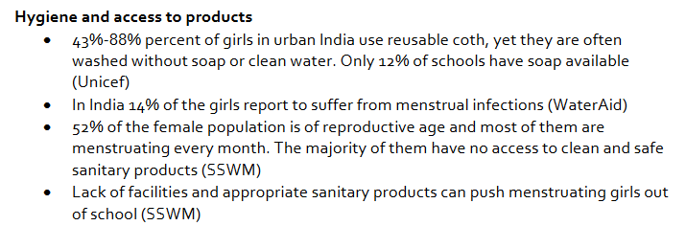

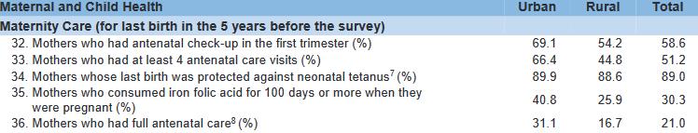
NFHS-IV 2015-16

Slide 6
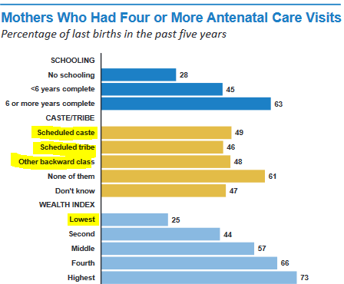
No definitive data on access to abortion related services, reproductive services accessed by women with disability

Slide 7
Other health conditions
Non-communicable diseases and chronic conditions (micronutrient deficiencies)
Mental health conditions (Suicide, depression)
Communicable diseases (HIV/AIDS)
Road traffic injuries
Physical and sexual violence

Slide 8
Older women (50+)

Slide 9
Social-cultural challenges and health
Lack of Social capital
Familial neglect, weakened or no social networks, access to healthcare, loss of spouse
Lack of social security leading to financial vulnerability
Physical and emotional violence perpetuated by family, relatives and financial exploitation
Political, Legal, Religion, Caste, Disability, Urban-rural mobility related challenges
Health

Slide 10
Health conditions
Non-communicable diseases (Stroke, hypertensions)
Mental health conditions (Suicide, depression)
Nutritional deficiencies
Physical, emotional and sexual violence; verbal abuse
Chronic conditions and disabilities

Slide 11
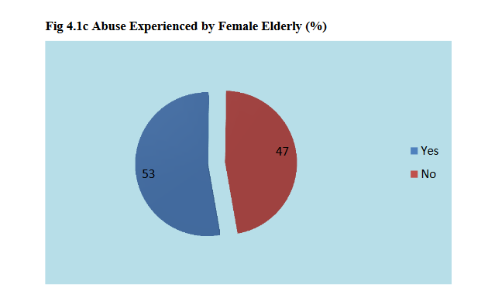
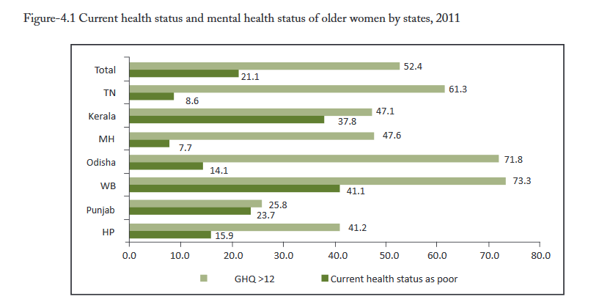
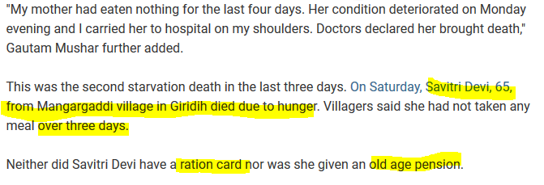
HelpAge India Annual report 2014
Building Knowledge base on Population Ageing in India. G. Giridhar
Two Starvation Deaths In Jharkhand In Last 3 Days, Chief Minister Orders Probe; NDTV India 2018

Slide 12
Recommendations
Inter-sectoral action on overlapping issues related to women’s health
Sensitization of community health workers to the need of elderly women
Financial support to CBOs, SHGs working for women specially women’s health and development
Proper implementation of existing health and welfare related plans and schemes, increase awareness about the schemes amongst women
Policies inclusive of women with disability in programs targeted at adult and elderly women

